Slide 1
PL-SQL Course

Slide 2
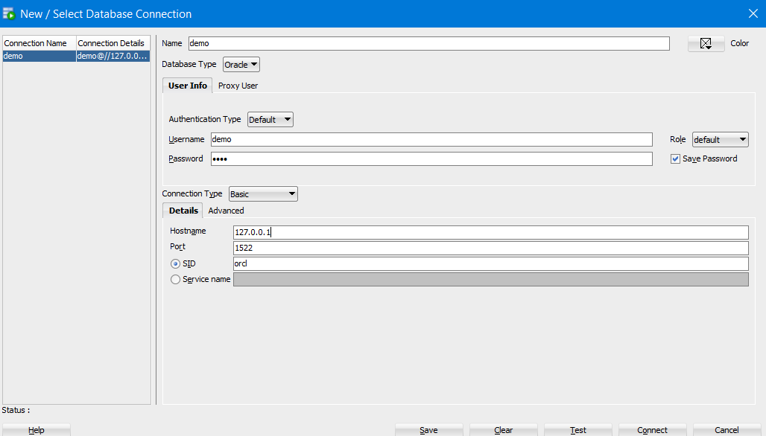
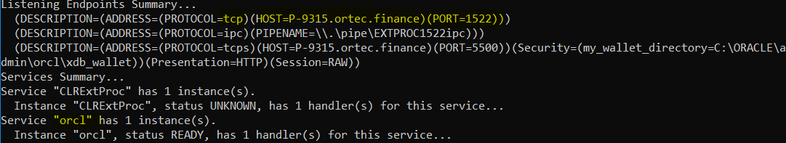
Installing
Install oracle 19c by following instructions on https://www.youtube.com/watch?v=KDu_VF9xaGk&t=870s
Stop at 14:30, the instructions are good till
Go to cmd and type lsnrctl status
Host is different now for some reason, but earlier it was 127.0.0.1

Slide 3
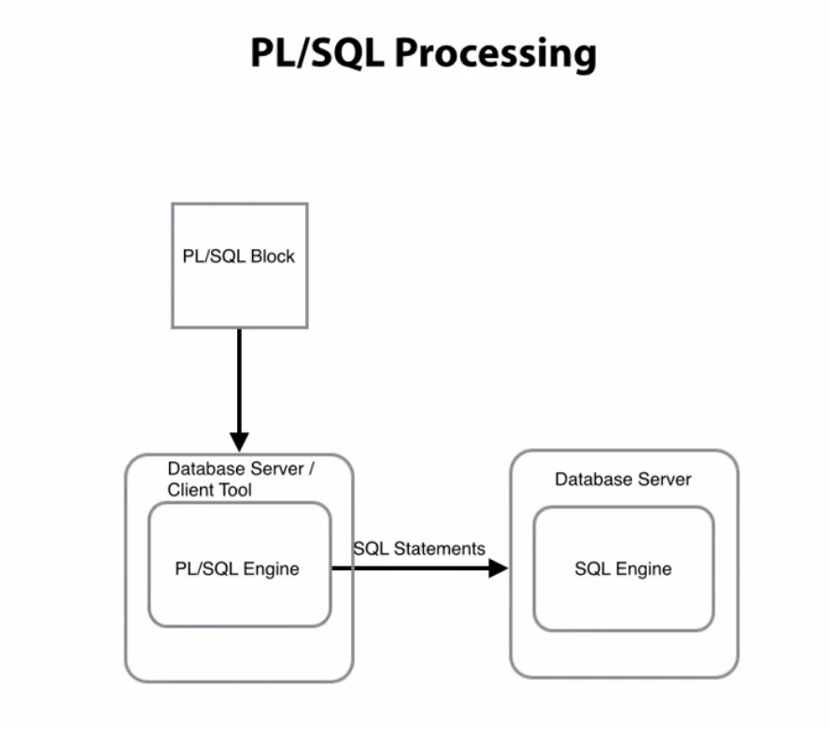
PL SQL performs checks and calculations on the PL SQL engine. (It clumps multiple statements and processes them). This reduces nr of server calls to the db and latency

Slide 4
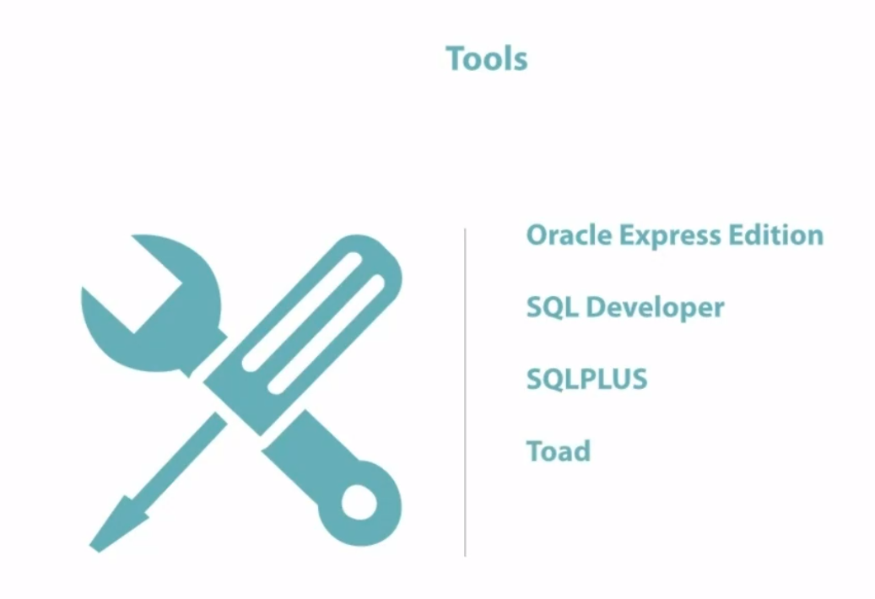

Slide 5
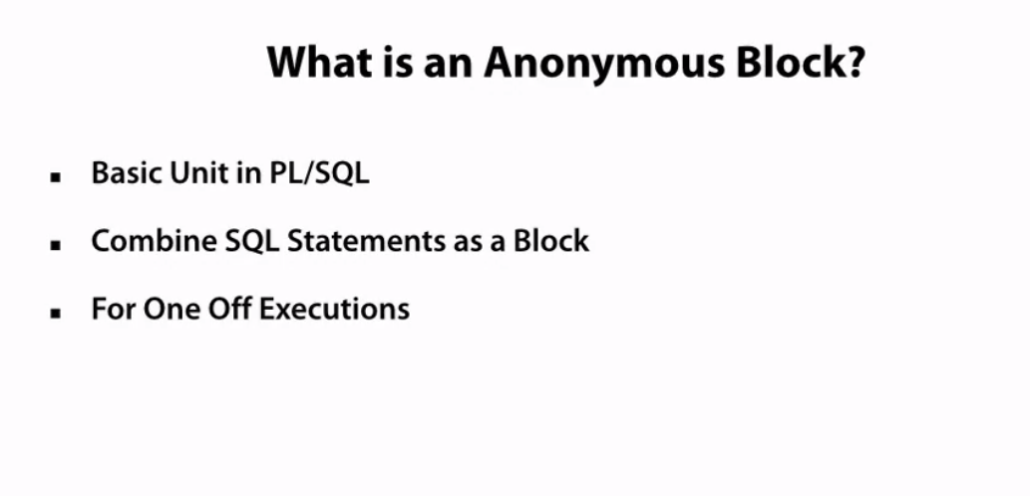
Only known to me (or to this is shared with) and used for one-off purposes like fixing something in prod

Slide 6
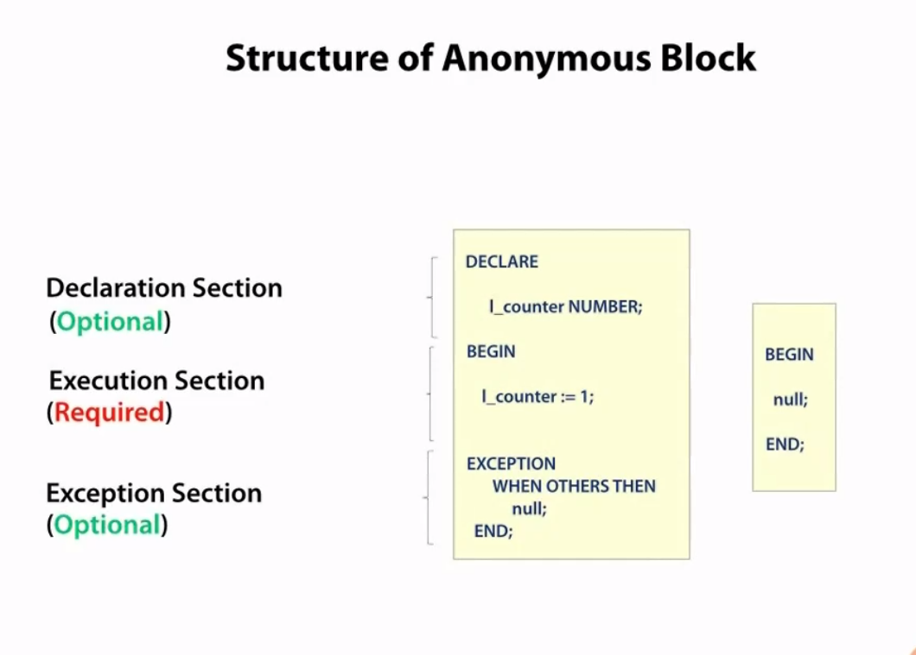
:= is assignment operator = is comparison operator
Case insensitive, can use a SQL formatter to prettify

Slide 7
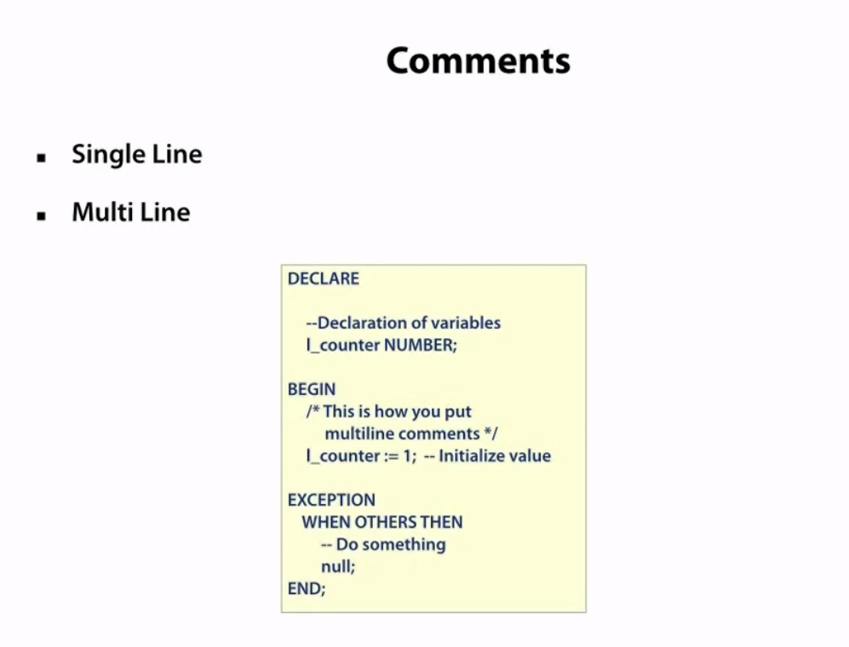
Good practices
Local vars: start with l_
Cursors: start with cur
Exceptions: start with e_

Slide 8
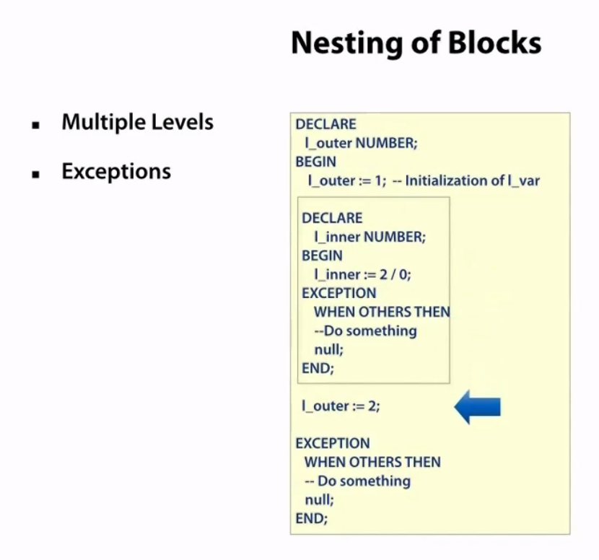

Slide 9
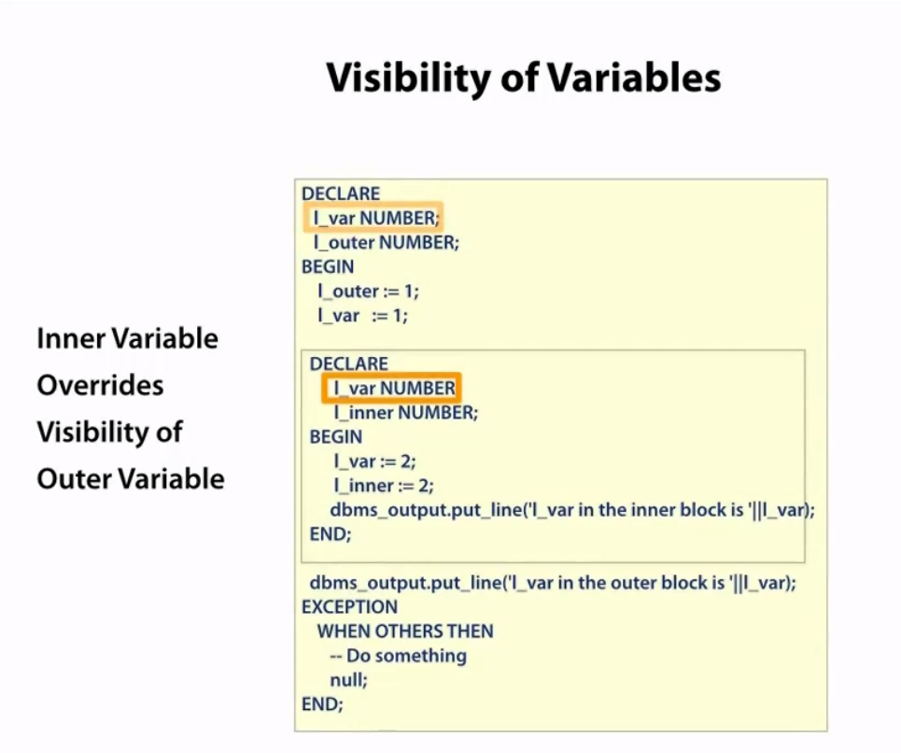

Slide 10
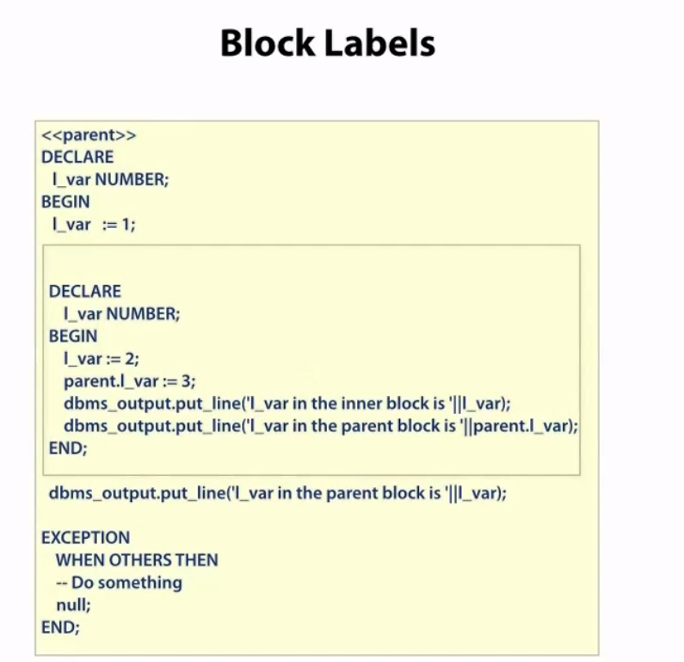
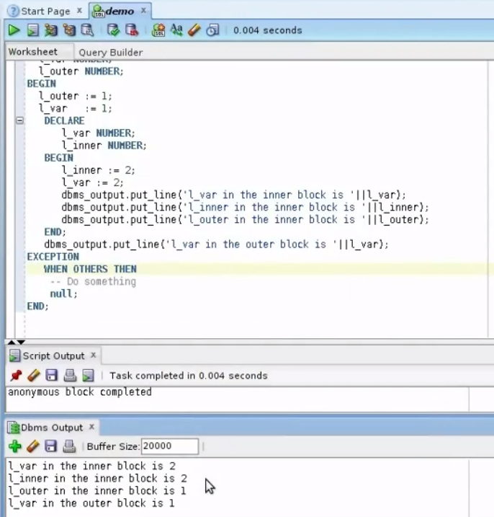

Slide 11
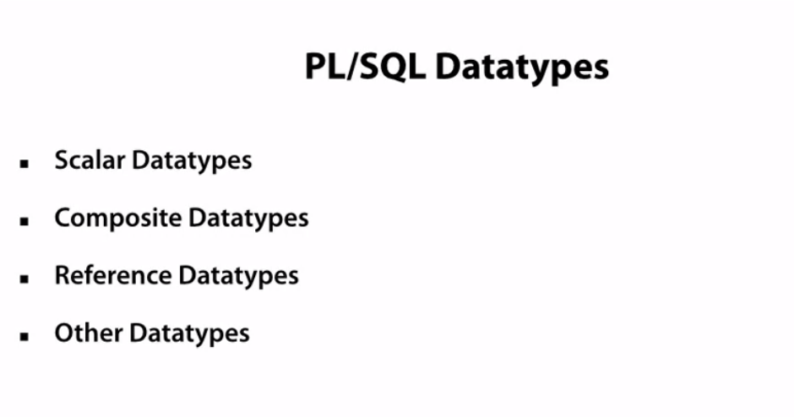
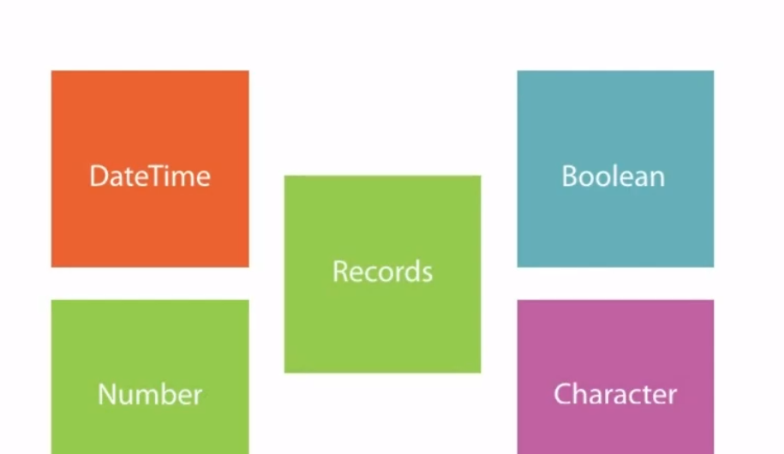
Scalar: Don’t have internal components
Composite: have internal components e.g. record/collections. Can be accessed by . Notation
Ref: Cursors
Other: For images etc (BLOB = Binary
BFILE = Stores files outside db as link

Slide 12
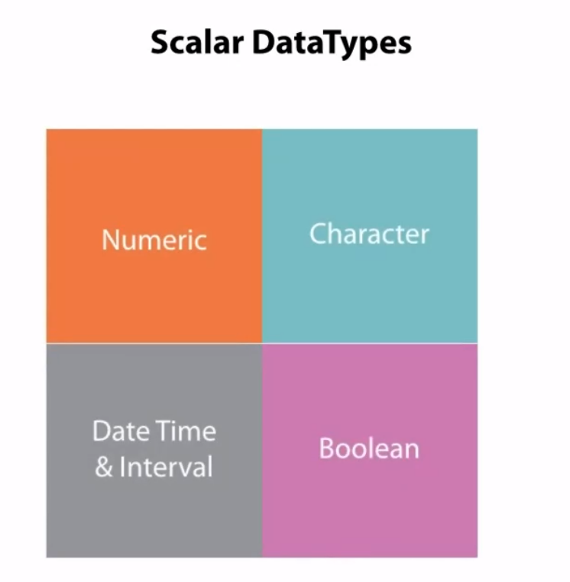
Char are defined by ‘ ’ and not
“ ”

Slide 13
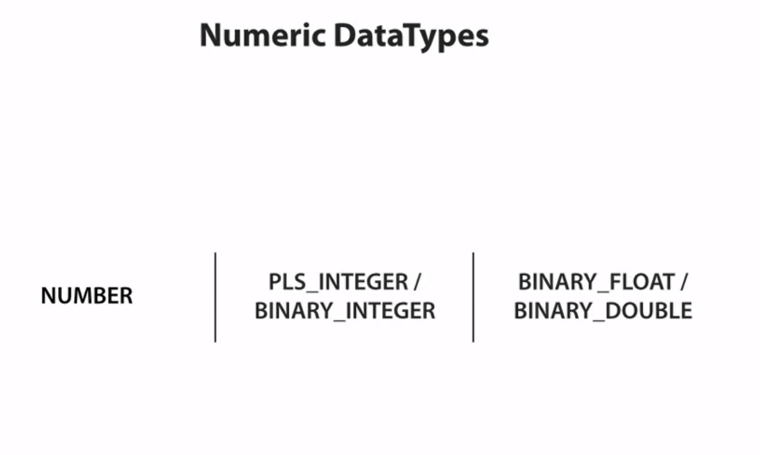
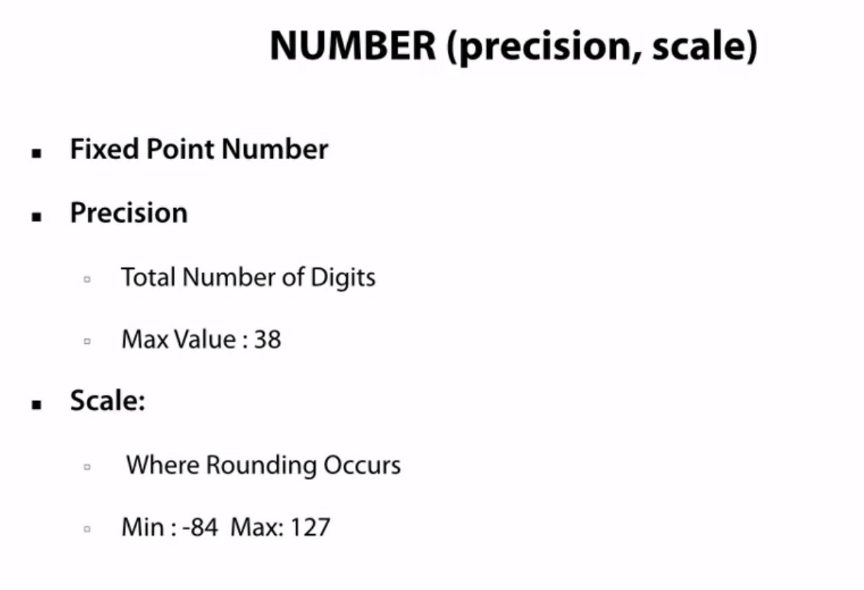

Slide 14
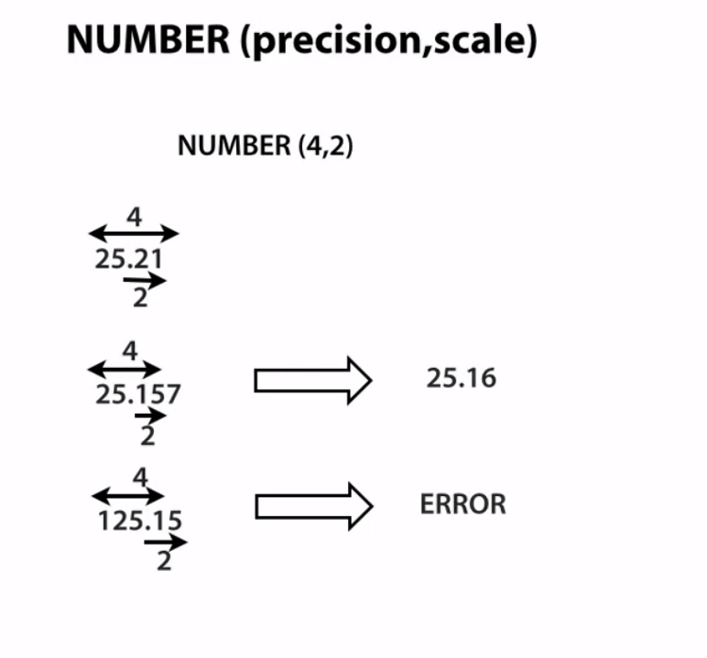
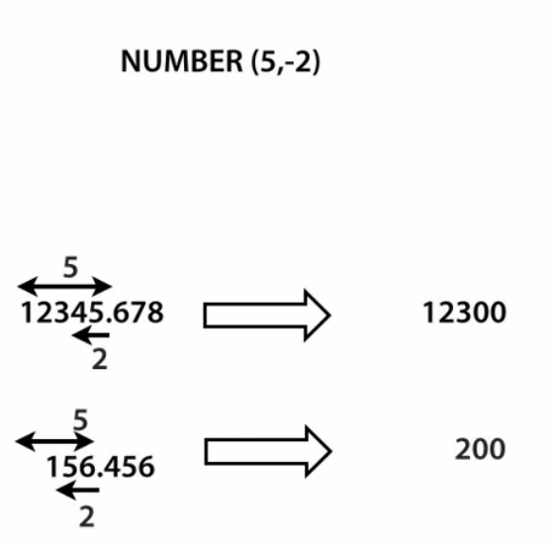
Need a precision of 5 with scale 2 to round the numbers after the decimal point
Precision = significant digits

Slide 15
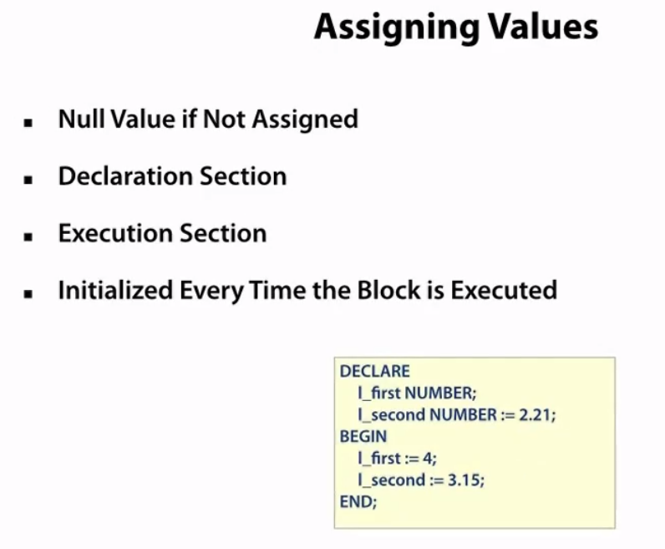
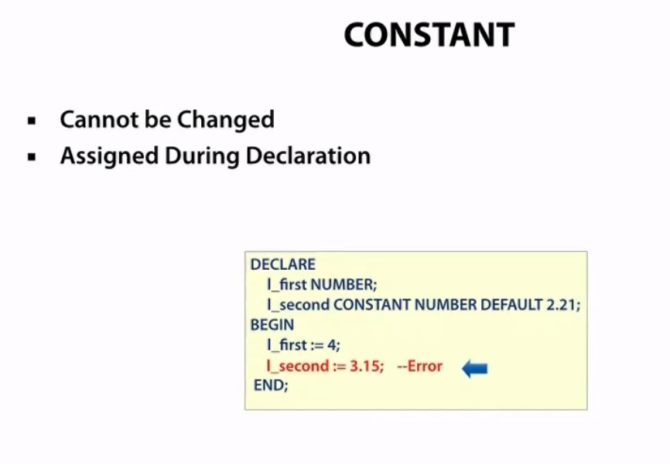

Slide 16
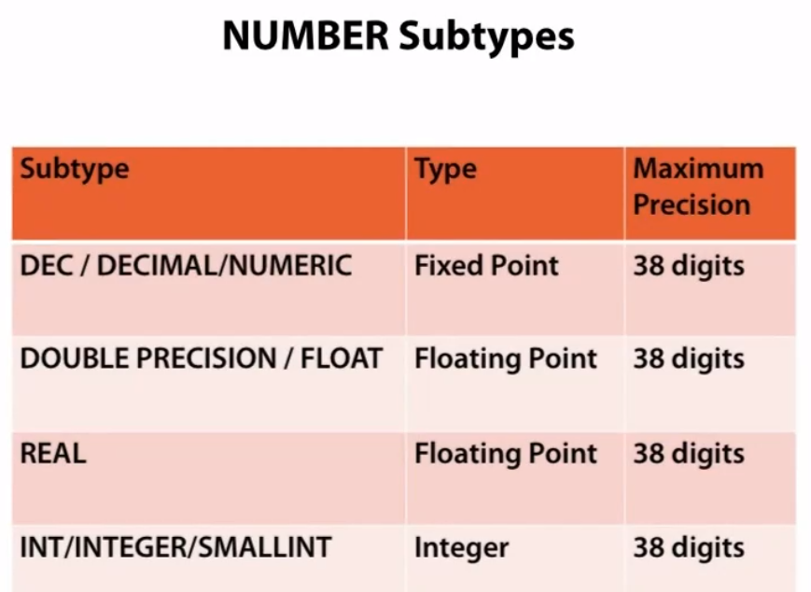
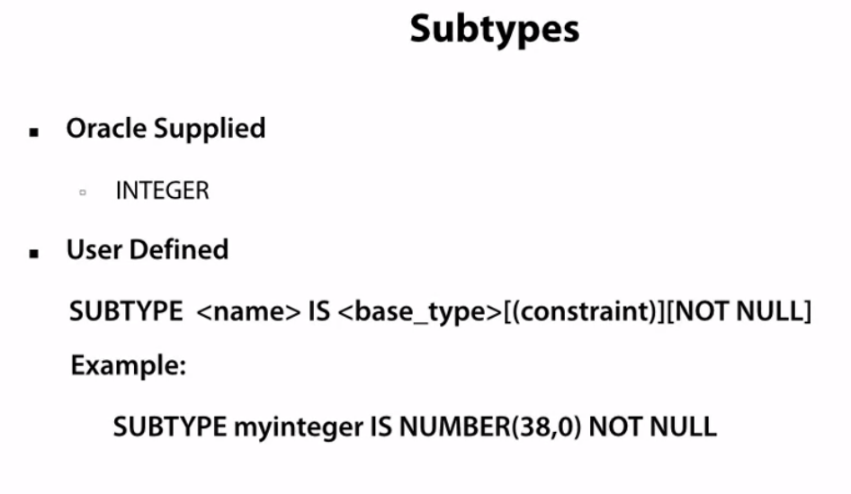
To set constraints and compatibility with ISO/ANSI

Slide 17
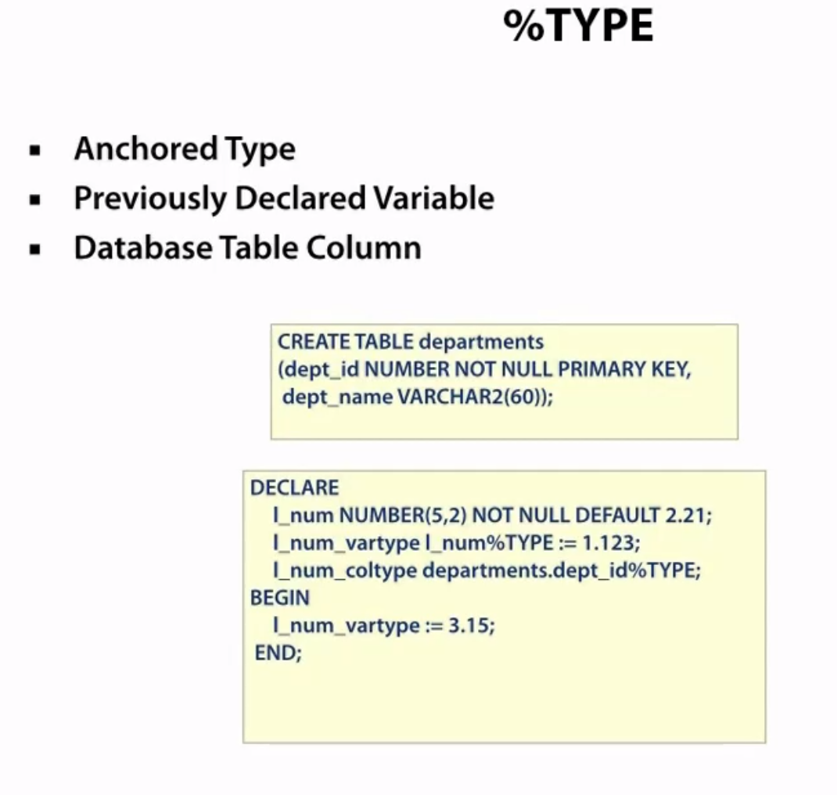
Good when a variable is dependent on another column of another table. However, the NULL constraints do not apply. But with another variable declared in the same block, then data type and constrains are both inherited

Slide 18
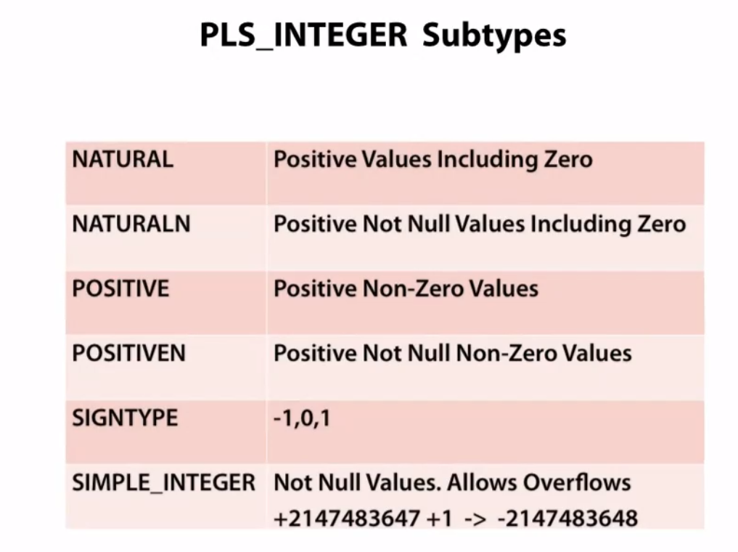
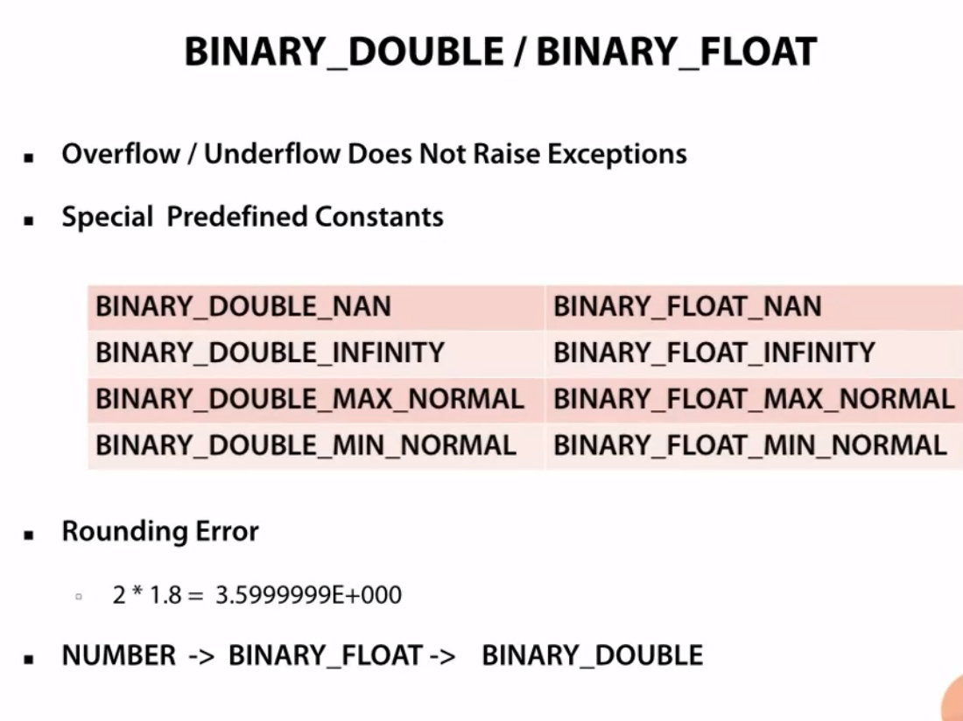
Good because these are faster as they are directly hardware dependent, unlike other data types which are software dependent. So if you are sure of the number range, like in a for-loop, good to use these
Binary data types are even more efficient since they are in base 2, but be careful as numeric calculations may not be very accurate (e.g we get 3.599 instead of 3.6. So for nrs with a small range or where precision is not important use binary. Also, take into account numeric precedence, if an operation involves number and binary double, the result will be converted to binary double
Also this datatype does not result in numerical overflow/underflow errors, divby0 error

Slide 19
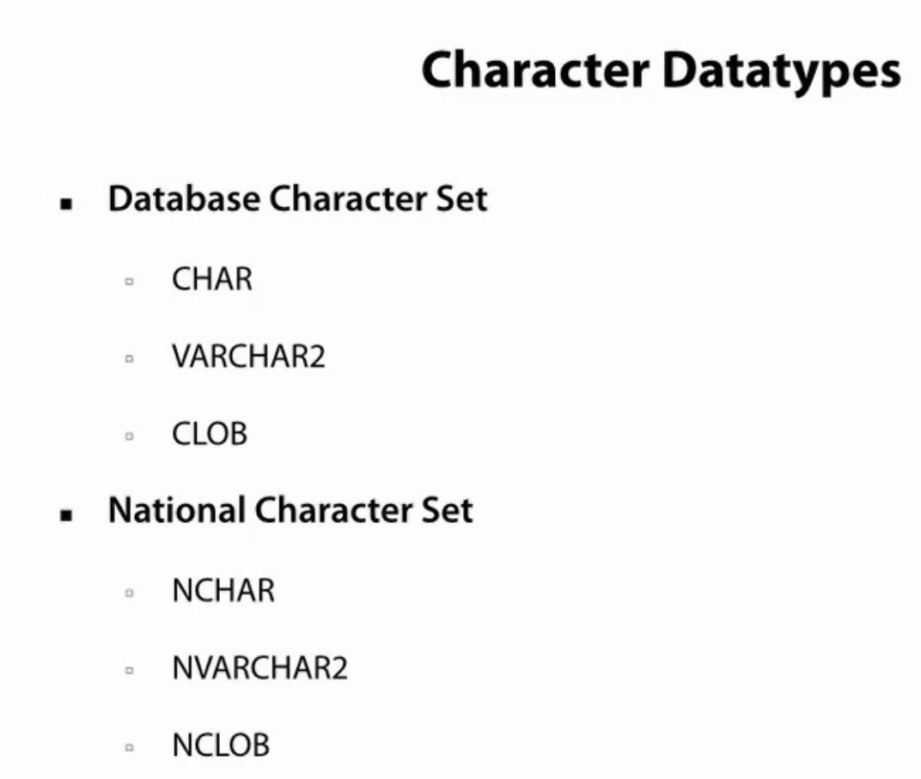
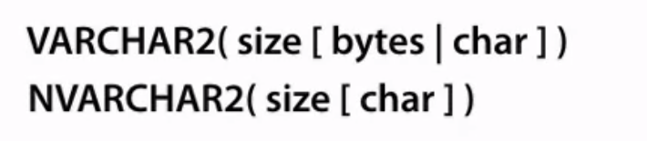
For global usage, supports all langs VARCHAR2 best, most space efficient and supportive
Character Large OBject
For English characters. NVARCHAR2 for other roman languages like French

Slide 20
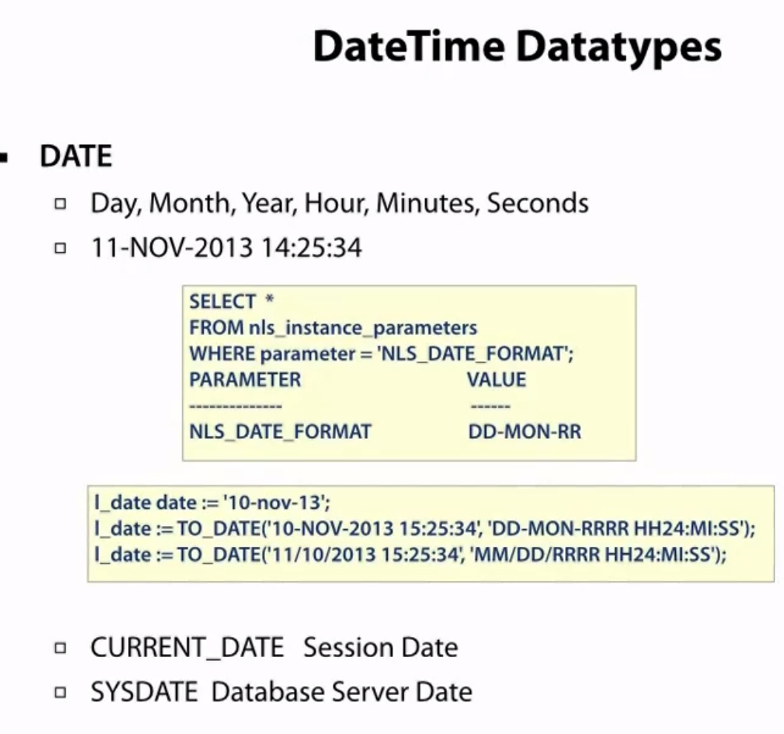
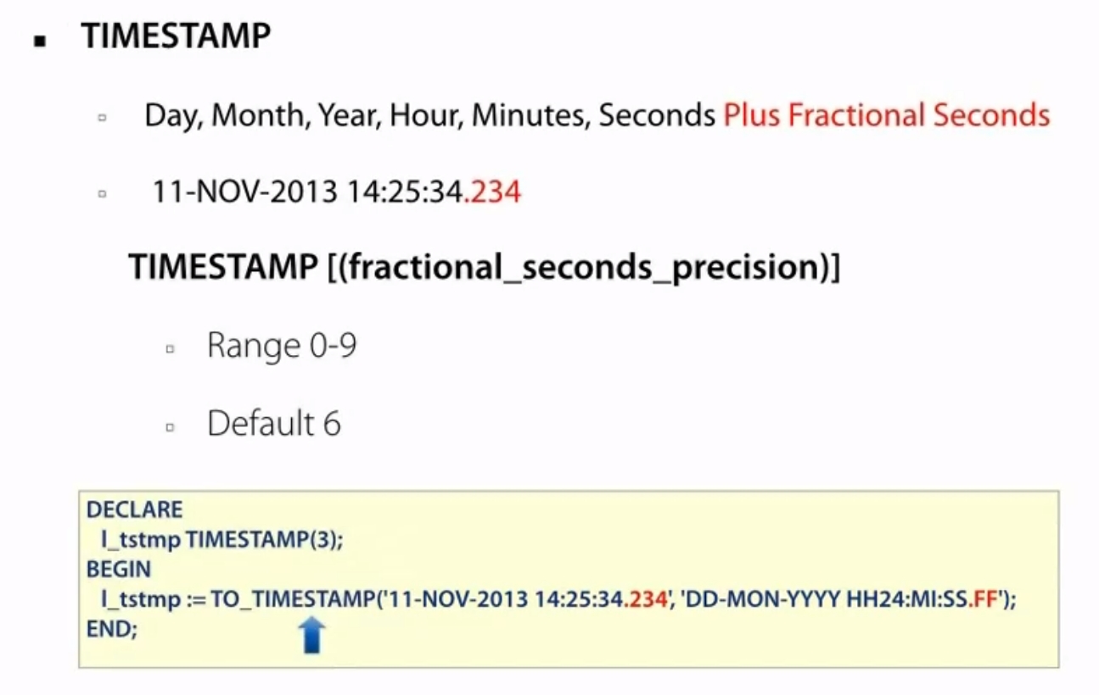
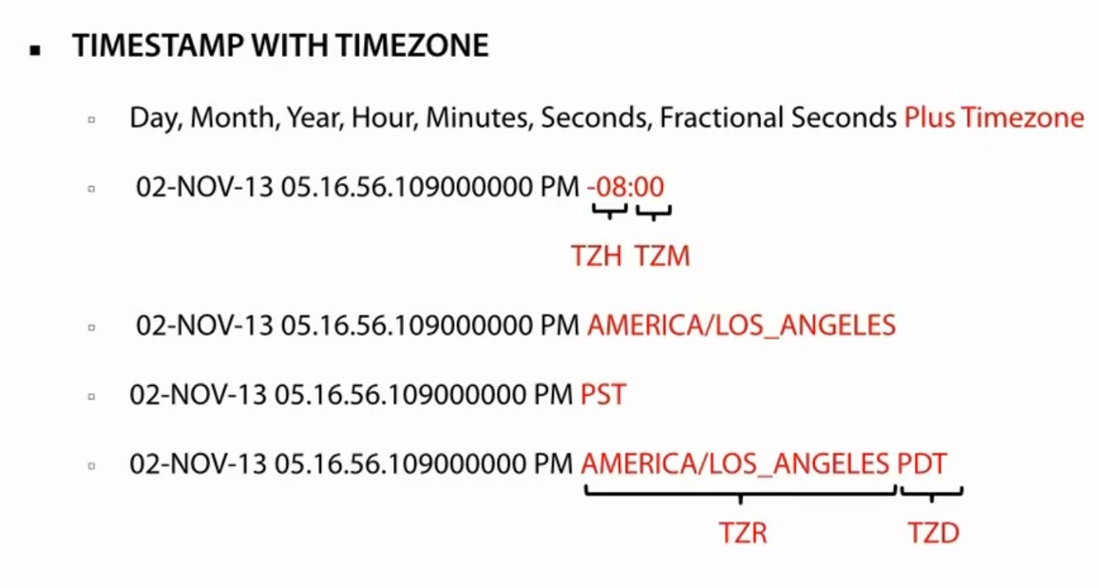
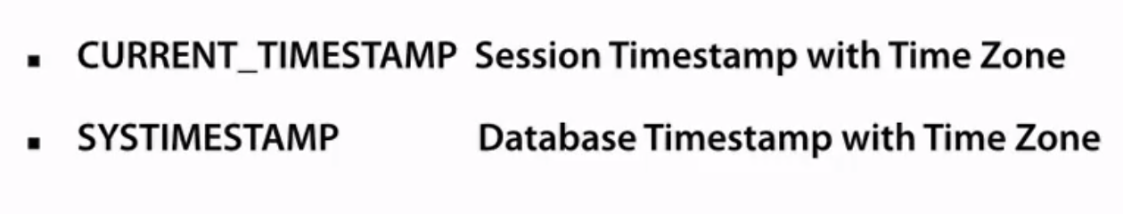
Always good to use TO_DATE, to explicitly define what the date is

Slide 21
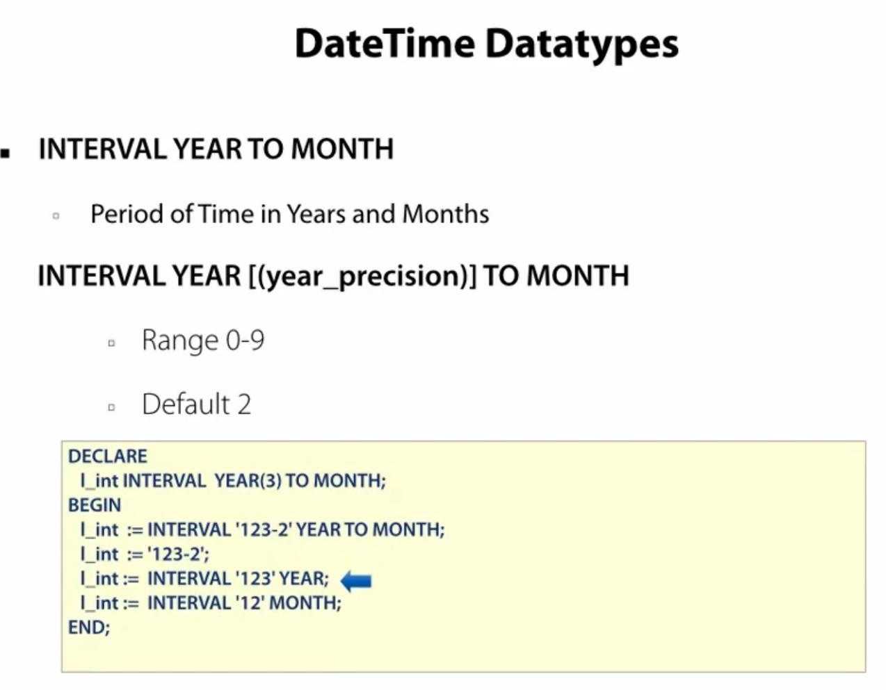
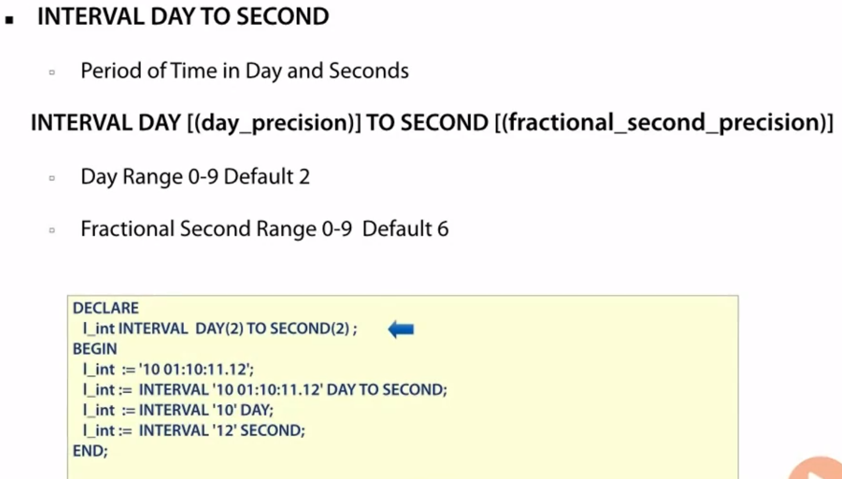
To calculate time-difference
Day to Second means down to day-second level
INTERVAL YEAR TO MONTH – which records a duration of years and months
INTERVAL DAY TO SECOND – which records a duration of days, hours, minutes and seconds.

Slide 22
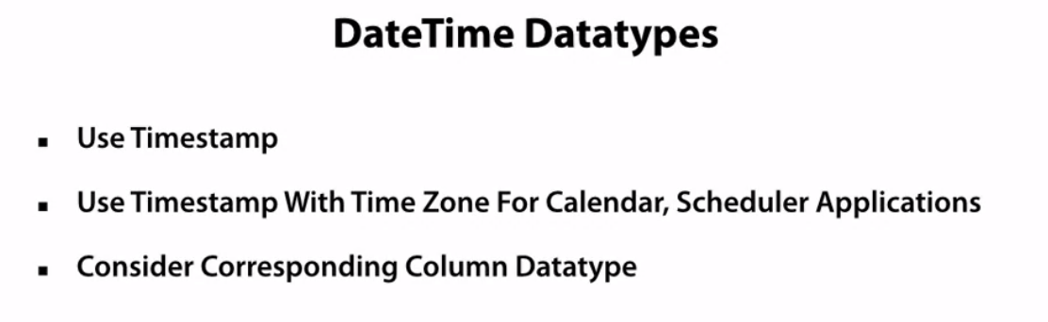
Good practice, esp for accuracy. Otherwise date type is also ok

Slide 23
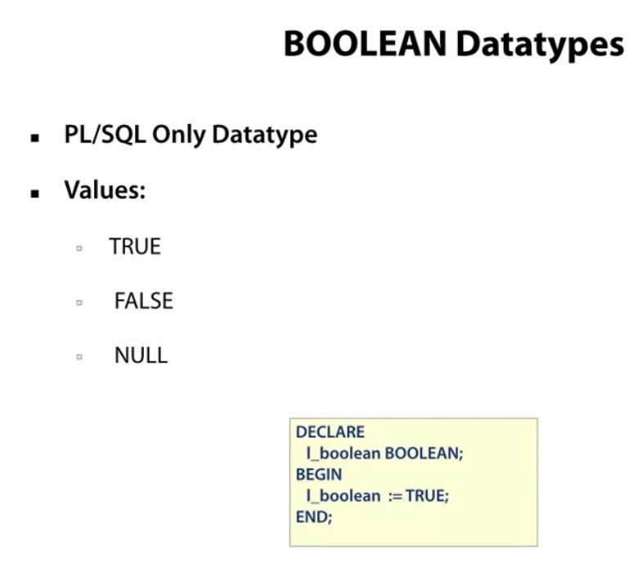
Cannot use 0 or 1 for T/F

Slide 24
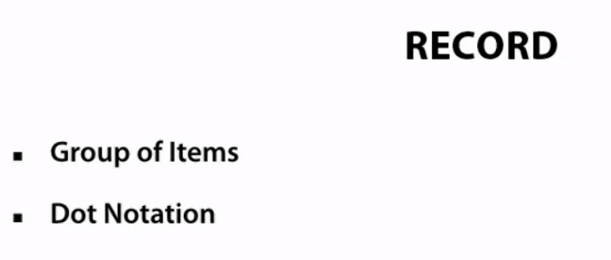
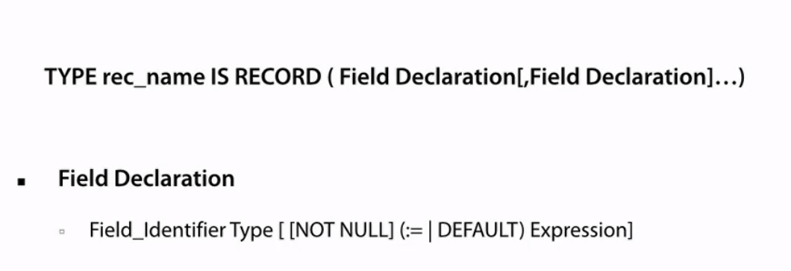
Composite Datatype (mix of dts)

Slide 25
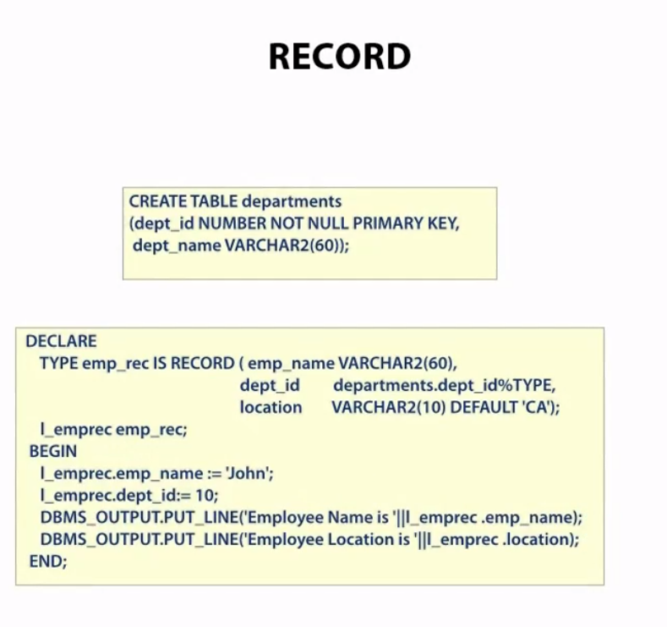
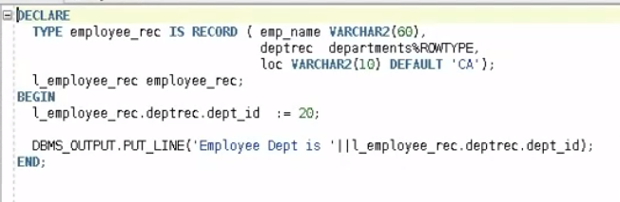
A record is accessible only in the anonymous block where it is declared. Unlike table elements which can be accessed globally
these values didn't exist in the dept table, but are present only in the record scope
Need to create another record variable of the type of emp_rec
Nesting is possible
The %ROWTYPE attribute provides a record type that represents a row in a database table. The record can store an entire row of data selected from the table

Slide 26
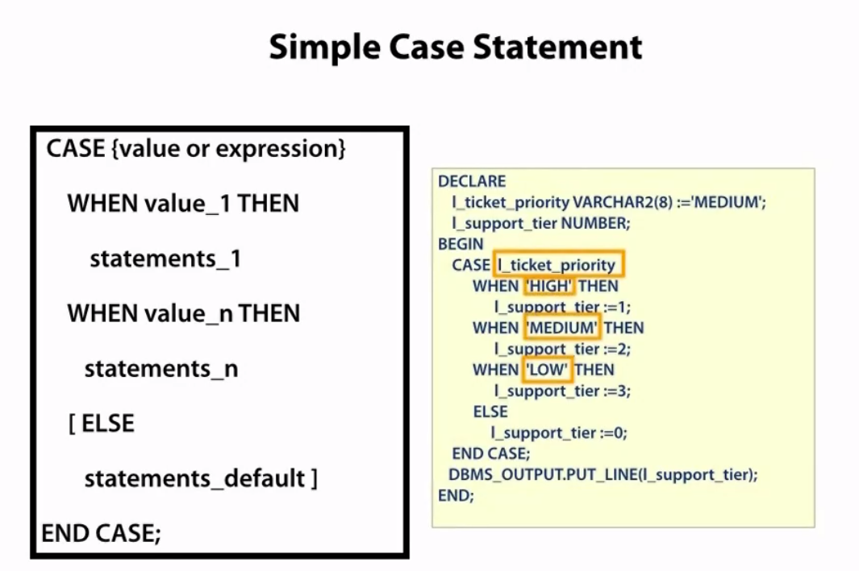

Slide 27
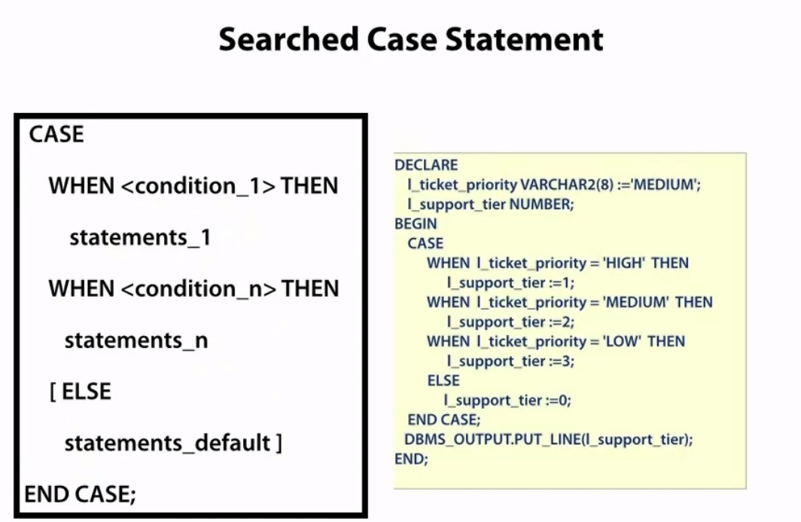
Case is preferable as it is compact. Simple case and Searched case evaluate from top to bottom and return a CASE NOT FOUND if no condition evaluates to True

Slide 28
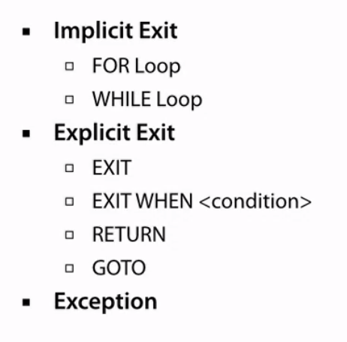
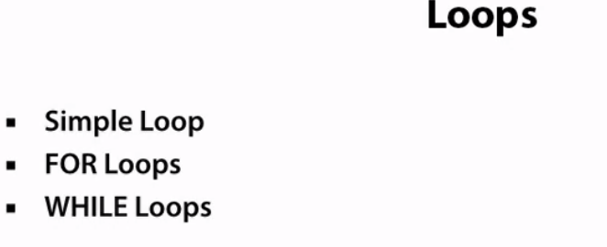

Slide 29
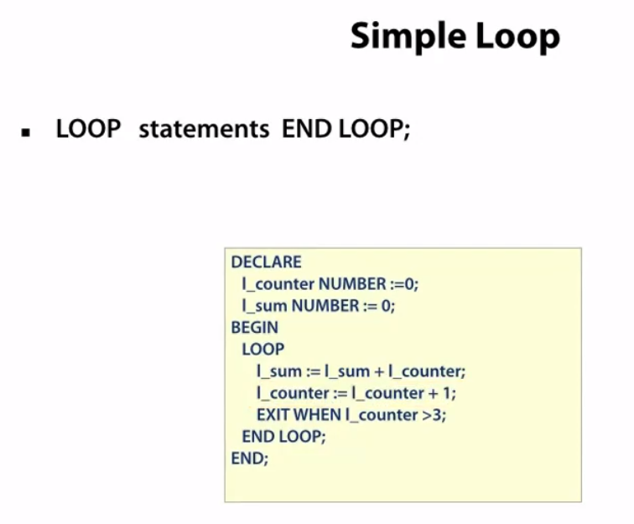
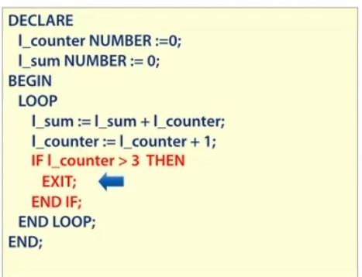
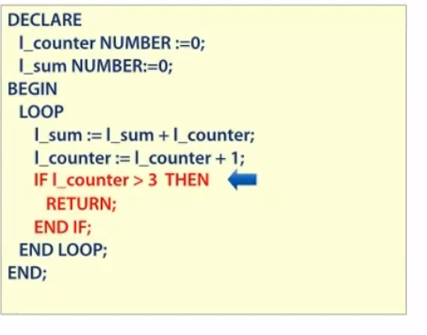
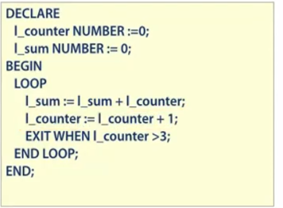
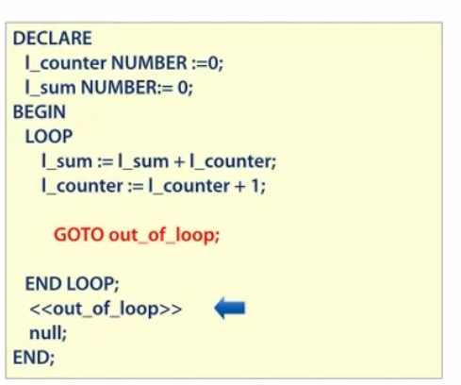
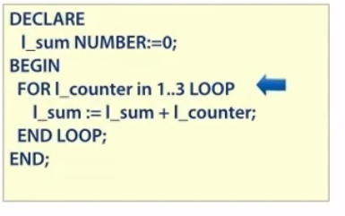
BEST Way
Avoid GOTO makes, spaghetti code
Can also have reverse loop

Slide 30
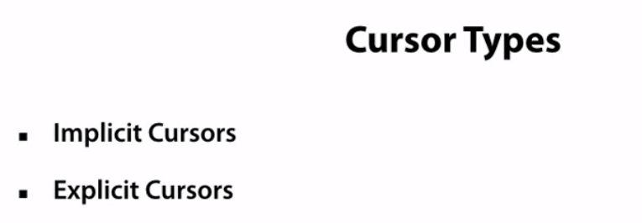
- Area in memory to hold the results for a SELECT, INSERT, UPDATE statement - Managed by Oracle
- Most common mode. Oracle executes your query but gives you control to open, fetch and execute cursor
- Must self-manage, but more control

Slide 31


Slide 32




Slide 33

Strong ref cursors = strict
Weak ref cursors = chill

